Slide 1

LSTM model for automated essay grading system-[Team 8]
TEAM MEMBERS:
19K41A04F5
19K41A0594
19K41A0596

Slide 2
OBJECTIVES
The main objective of our project is to create deep learning model for Automated essay scoring (AES).
It is a computer-based assessment system that automatically scores or grades the student responses by considering appropriate features.
Its objective is to classify a large set of textual entities into a small number of discrete categories, corresponding to the possible grades, for example, the numbers 1 to 6.
Automated scoring means using machines to evaluate things typically evaluated by people.
The data includes features like essayid,essayset,essay

Slide 3
BENEFICIARIES
It takes much less time to score, ensuring that results and feedback can be provided instantly.
This is especially important with university and college classes that are so large it would be almost impossible to give each student frequent, detailed, individualized feedback.
AES grades each essay based on its own merits, and similar papers will receive the same grade.
it is beneficial for teachers they no need correct papers manually it decreases the burden.
students no longer need to wait for their score.

Slide 4
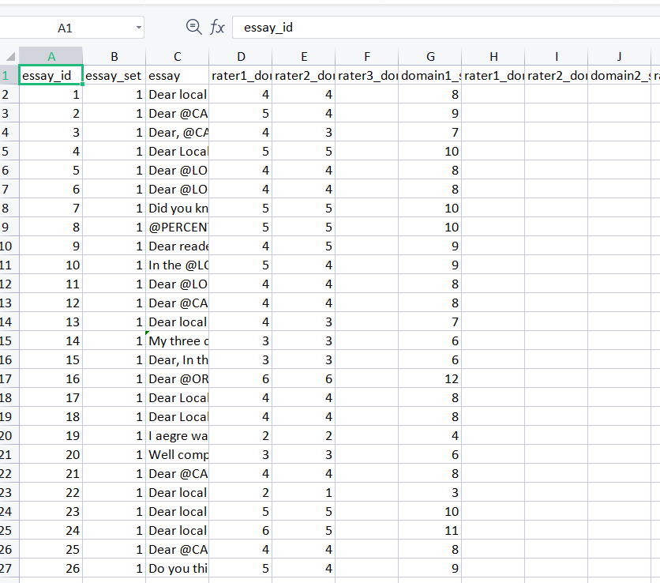
AES DATASET
For Automated essay grading we need dataset. The dataset to work on and we decided to use the long short term memory network Model. Create a model that will help us to estimate of score for given essay .
Dataset contains:
12976 rows X 28 columns

Slide 5
LSTM - DEEP LEARNING MODEL
The previous or existing automated essay grading systems used traditional text based machine learning models. The results highly rely on the crafted extracted features. The performances are unstable when grading different essays from various topics.
So,we propose a deep learning model based LSTM(Long short term memory) method for grading essays automatically
During computation of long essays which are far away,it is impossible to store which causes vanishing of gradient in RNN.Inorder to maintain we use LSTM(Long Short-Term Memory Network)

Slide 6
RESULT NEURAL NETWORK LOSS AND MAE
NUMBER OF EPOCHS
NUMBER OF FOLDS
kappa score
0.83
0.83
0.84
0.81
0.83
1 | 2 | 3 | 4 | 5 | 6
65.2 | 41.8 | 34.3 | 31.8 | 29.7 | 27.9
4.4 | 3.6 | 3.4 | 3.4 | 3.2 | 3.0
65.3 | 40.6 | 34.0 | 30.6 | 27.9 | 27.0
4.3 | 3.6 | 3.4 | 3.3 | 3.2 | 3.0
61.7 | 39.7 | 33.0 | 30.4 | 28.6 | 26.4
4.2 | 3.5 | 3.4 | 3.3 | 3.2 | 3.0
63.6 | 39.8 | 33.4 | 30.3 | 28.1 | 26.5
4.3 | 3.5 | 3.4 | 3.4 | 3.2 | 3.0
63.8 | 39.9 | 33.5 | 30.8 | 28.33 | 26.68
1
2
3
4
5
LOSS
MAE
LOSS
MAE
LOSS
MAE
LOSS
MAE
LOSS
MAE
4.3 3.5 3.4 3.3 3.2 3.0
Average kappa score after 5-fold cross validation :0.834

Slide 7
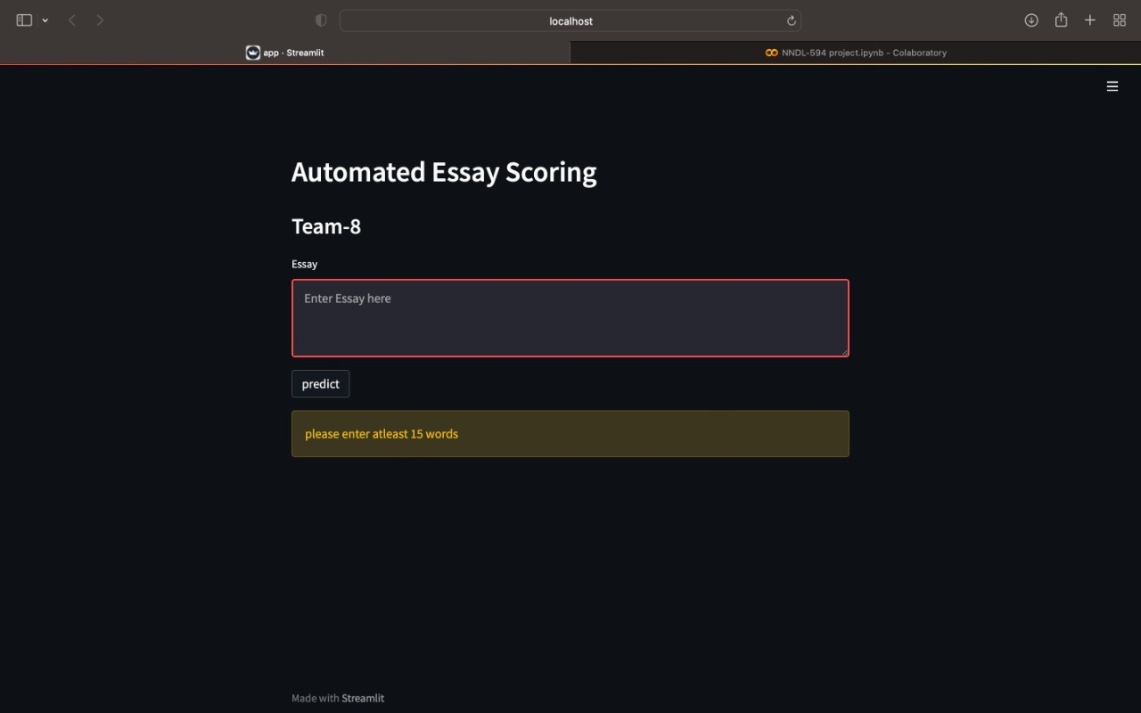
APPLICATION

